Slide 1
CS 252 Database Management Systems
Jan – May 2020
IV Semester
* Use the slides for reference only. Refer the text book for details.

Slide 2
University database
The university is organized into colleges (COLLEGE), and each college has a unique name (CName), a main office (COffice) and phone (CPhone), and a particular faculty member who is dean of the college.
Each college administers a number of academic departments (DEPT).
Each department has a unique name (DName), a unique code number (DCode), a main office (DOffice) and phone (DPhone), and a particular faculty member who chairs the department. We keep track of the start date (CStartDate) when that faculty member began chairing the department

Slide 3
University database
A department offers a number of courses (COURSE), each of which has a unique course name (CoName), a unique code number (CCode), a course level (Level: this can be coded as 1 for freshman level, 2 for sophomore, 3 for junior, 4 for senior, 5 for MS level, and 6 for PhD level), a course credit hours (Credits), and a course description (CDesc). The database also keeps track of instructors (INSTRUCTOR); and each instructor has a unique identifier (Id), name (IName), office (IOffice), phone (IPhone), and rank (Rank); in addition, each instructor works for one primary academic department.
The database will keep student data (STUDENT) and stores each student’s name (SName, composed of first name (FName), middle name (MName), last name (LName)), student id (Sid, unique for every student), address (Addr), phone (Phone), major code (Major), and date of birth (DoB). A student is assigned to one primary academic department. It is required to keep track of the student’s grades in each section the student has completed.

Slide 4
University database
Courses are offered as sections (SECTION). Each section is related to a single course and a single instructor and has a unique section identifier (SecId). A section also has a section number (SecNo: this is coded as 1, 2, 3, . . . for multiple sections offered during the same semester/year), semester (Sem), year (Year), classroom (CRoom: this is coded as a combination of building code (Bldg) and room number (RoomNo) within the building), and days/times (DaysTime: for example, ‘MWF 9am-9.50am’ or ‘TR 3.30pm-5.20pm’— restricted to only allowed days/time values). (Note: The database will keep track of all the sections offered for the past several years, in addition to the current offerings. The SecId is unique for all sections, not just the sections for a particular semester.) The database keeps track of the students in each section, and the grade is recorded when available (this is a many-to-many relationship between students and sections). A section must have at least five students.

Slide 5

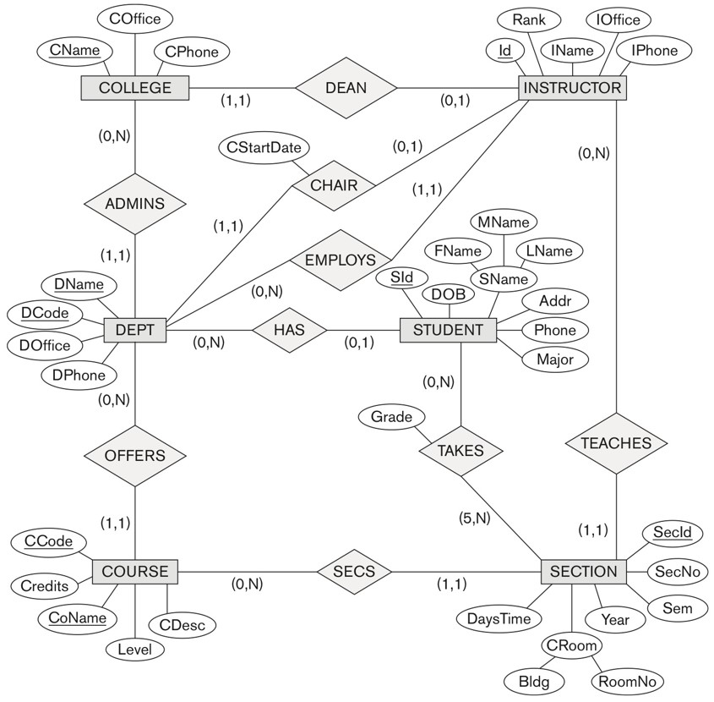
UNIVERSITY database conceptual schema

